Slide 1
Lecture 4: APIs and Microservices
February 18, 2019

Slide 2
Today
Basic Workflow
Basics of REST
Intro to Microservices
Principles of Agile

Slide 3
Suggested Reading
Building Microservices, section “Orchestration Versus Choreography”
http://index-of.es/Varios/Sam%20Newman-Building%20Microservices-O'Reilly%20Media%20(2015).pdf
The Agile Manifesto and the Twelve Principles
https://agilemanifesto.org/
https://agilemanifesto.org/principles.html
Twelve-factor Apps
https://12factor.net/
Good Read if Microservices
are interesting

Slide 4
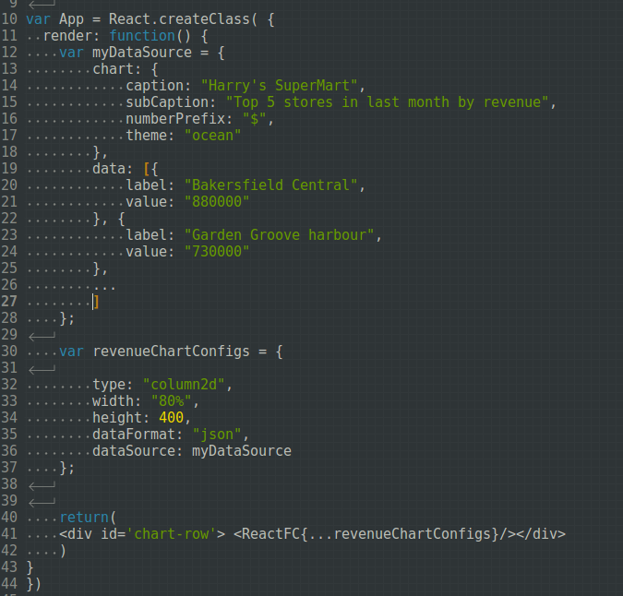
Last time...
Chart labels
Chart data
Chart layout metadata

Slide 5
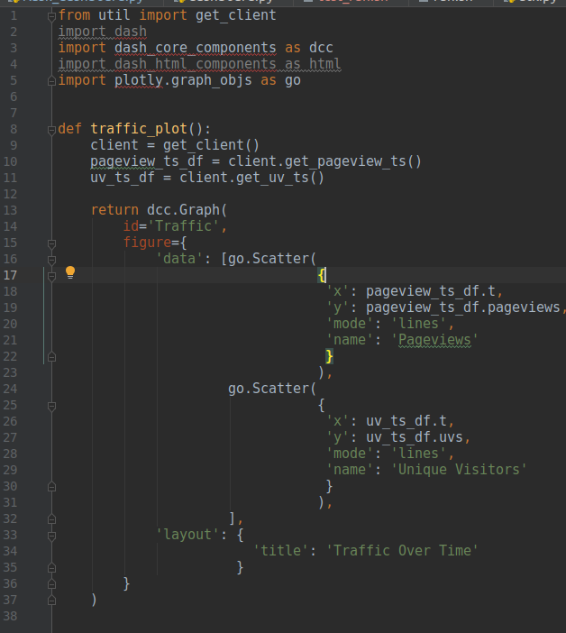
The dashboard used a client to get data

Slide 6
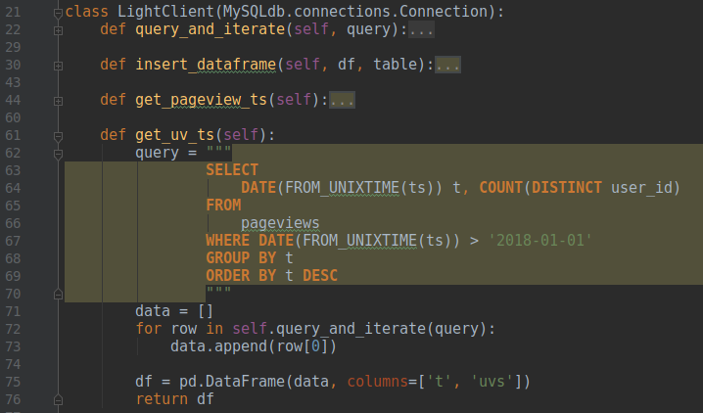
The client implemented SQL queries

Slide 7
A better model:
Use an API instead of (or with) a python client as the interface to your database
You can set rate limits
You can restrict to only specific queries
Instead of propagating changes through a client, you’re even more decoupled!

Slide 8
Last time:
Tornado
A Python web framework
Great for APIs
More features:
Handles sync/async methods well
Can act as a scheduler or a queue-reader, too!

Slide 9
Review of Tornado

Slide 10
Basic Data Structures:
minimally...
tornado.web.Application
Define routes to different endpoints, and enumerate the handlers for each
Parse parameters to pass on to request handlers
tornado.web.RequestHandler
Define methods to handle http verbs
Process the request, and provide a response

Slide 11

Execution
A listener runs on a loop, called the IOLoop
tornado.ioloop.IOLoop contains a set of tools for dealing with the IOLoop
This one gets involved … we’ll come back to it throughout the course

Slide 12
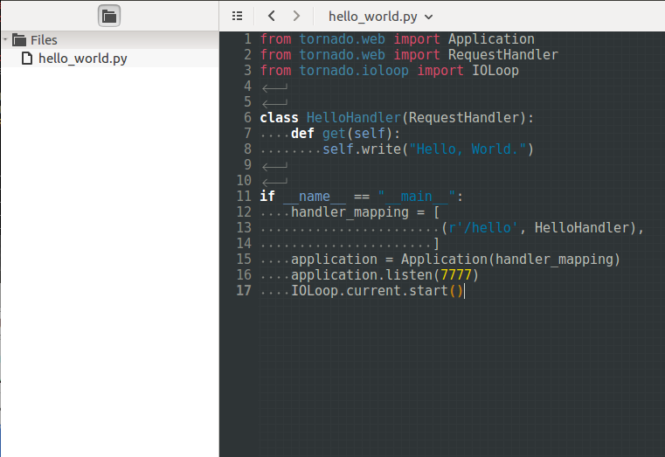
Hello World
Create the app
Start the http server

Slide 13
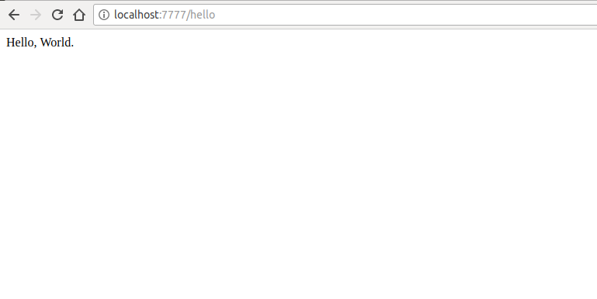
Try it!

Slide 14
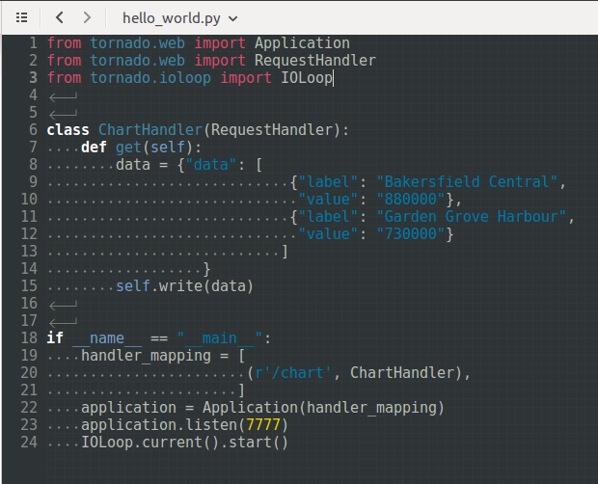
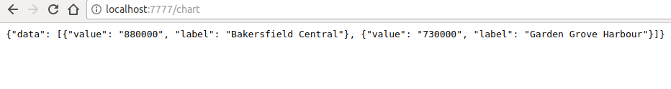
Slightly more interesting...
Last time, a client queried a database and returned data
What if instead, we called another API?
We can have the API do something like this:

Slide 15
Still not very interesting...
We should accept other user input
We should create the content to return dynamically!

Slide 16
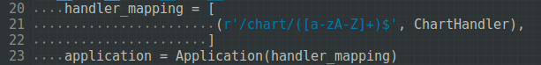
The routing uses RegEx capture...
Items in parentheses are captured and passed to the RequestHandler as args: another way to collect data!
404 if your request doesn’t match the RegEx!
Regex: The parantheses capture the argument
Regex - Greedy match until it encounters a character that doesn’t match
+ stands for 1 or more and * stands for 0 or more

Slide 17
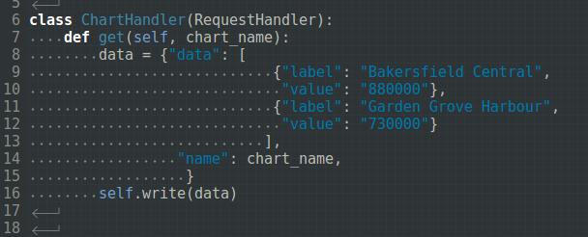
Just add the captured data to the args

Slide 18
We want to abstract the data source...
De-couples the application and the data source
Keeps the front-end independent of the API: just renders named charts!
Makes it easy to change the data source
Dashboard
Data API
Database

Slide 19
You can build this in 15 minutes from the minimal website!

Slide 20
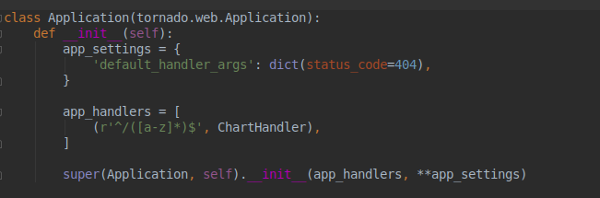
We capture the chart name with an argument (see the regex capture)
The argument passes through to the app
http://0.0.0.0:8000/uniques
http://0.0.0.0:8000/pageviews

Slide 21
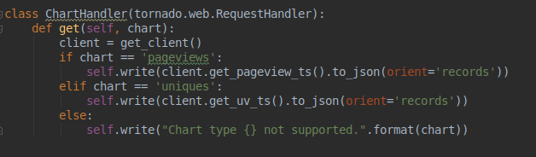
We capture the chart name with an argument (see the regex capture)
The argument passes through to the app
http://0.0.0.0:8000/uniques
http://0.0.0.0:8000/pageviews

Slide 22
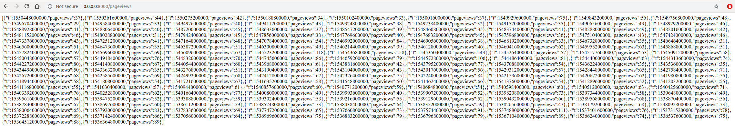

Slide 23
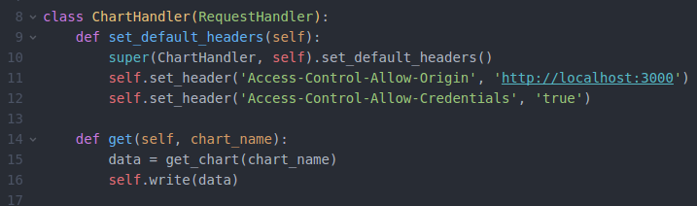
We have to worry about access...
We have to allow the requests from this domain

Slide 24
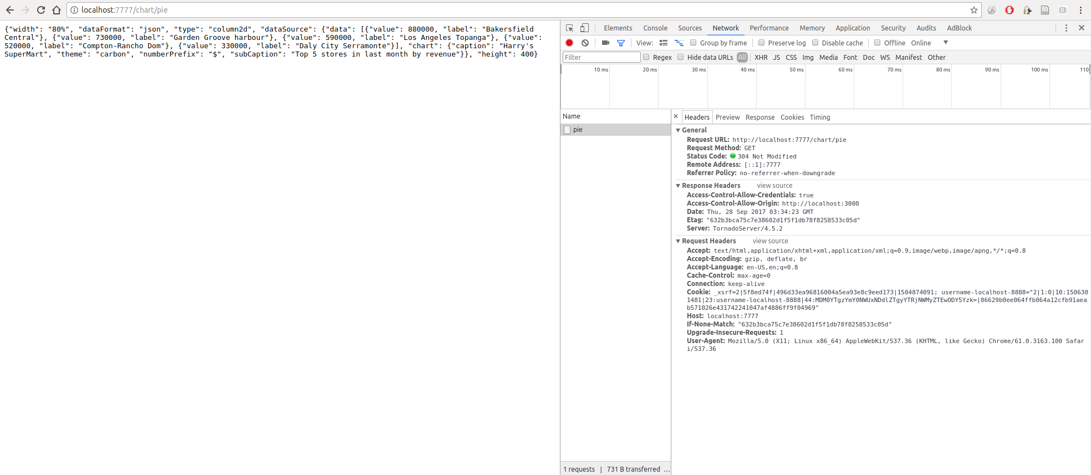
Debugging can be tricky!
“Network” tab
JavaScript
Console

Slide 25
In some ways, these cases were simple...
How should we think of requests more generally?
REST: REpresentational State Transfer
Stateless API:
The server doesn’t know about the client state -- it just serves requests
The client makes requests, and transitions from one state to another
Stateful Client:
The client maintains the context of what’s going on
Client State Transitions:
With HTTP, implements HTTP verbs
GET, POST, PUT, DELETE

Slide 26
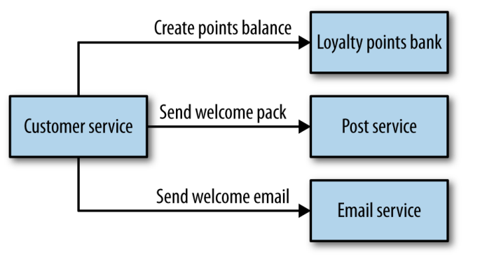
More generally… MusicCorp example
Customer signs up on the website
We want to
Start a loyalty account
Send a welcome package
Send a welcome email
Customer Service is what the user interacts with on the browser
Each service will have an SLA and that has to be considered before the application uses the service
https://www.nginx.com/wp-content/uploads/2015/01/Building_Microservices_Nginx.pdf

Slide 27
More generally… MusicCorp example
We create a Customer resource
We tell the loyalty service to start the loyalty account
It performs the action, and confirms
We update the customer state
We tell the post service to send the welcome package
State transition like above
We tell the email service to send the welcome email
same
https://www.nginx.com/wp-content/uploads/2015/01/Building_Microservices_Nginx.pdf

Slide 28
More generally… MusicCorp example
Drawbacks:
Customer service can get big
Things are tightly coupled
Adding new functions requires updating the Customer service
https://www.nginx.com/wp-content/uploads/2015/01/Building_Microservices_Nginx.pdf

Slide 29
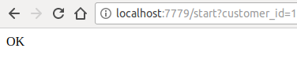
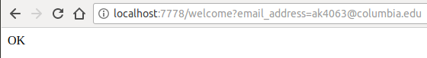
MusicCorp implementation
Loyalty
Email

Slide 30
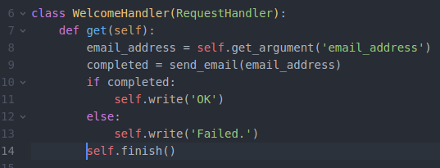
Loyalty and Email are simple

Slide 31
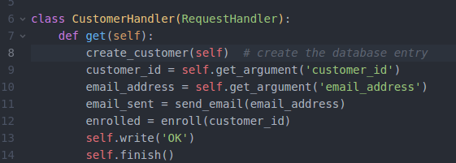
But Customer is getting complex...
We want to achieve 100 to 150 ms latency for all the tasks to be done

Slide 32
Customer is ...
Maintaining Customer state
Being the brain for the other services
It has to implement all of the logic to handle the responses!

Slide 33
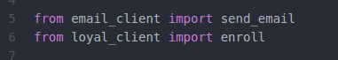
Coupling through shared libraries
It’s a bit trickier, too

Slide 34
We have to implement the API requests...
We can abstract away all implementation details with the shared client -- robust to (some) API changes!
What happens if we do need to change the interface?
More metadata in the response?
Require more information in the request?
Require each client to auth?

Slide 35
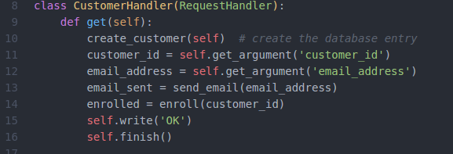
A little on Blocking
We’re making several API calls
Each call can take some time to execute
They’re happening synchronously: we have to wait the sum of the response times!

Slide 36

There must be a better way!

Slide 37
Asynchronous requests!
Networks are slow and unreliable
Expect failures and latency

Slide 38
Don’t wait on the network!
Make a request, and return immediately, without the response
Make another request while you’re waiting, then come back to check on the first
Continue until you’re ready to move on
You’re free to handle many more requests concurrently!

Slide 39
What does this look like?
Pass around generators instead of data
yield when you receive a generator so you can do more work
Raise special exceptions to return values

Slide 40
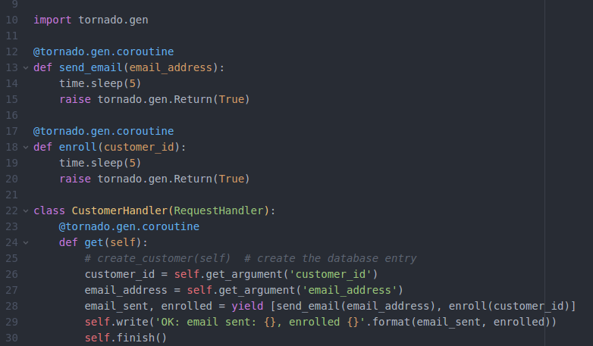

Slide 41
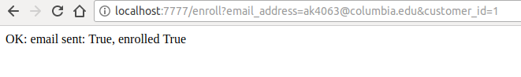
The Customer service, synchronous
Takes 10 seconds to return!

Slide 42
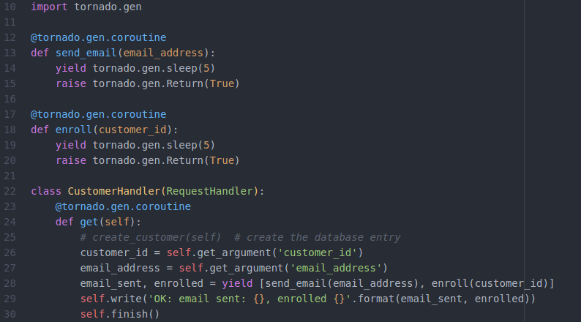
The Customer service, async
Acts like a network request that takes 5 seconds

Slide 43
The Customer service, async
Takes 5 seconds to return!

Slide 44
But we still have the complexity of Customer
What can we do to simplify the API service?

Slide 45
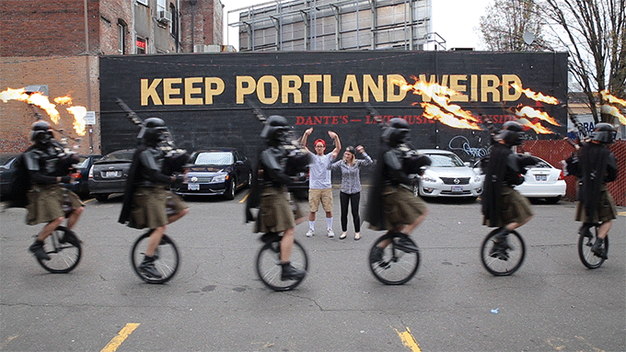
Pipelines!
Data is broadcast out to different channels
Services listen to the channels, ready to act
They receive a message, and process it (often without responding)

Slide 46
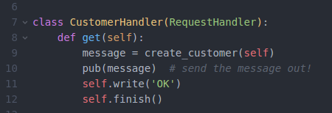
How does this work?
Publish messages instead making a series of API calls
Message = { “event_id”: 1234, “type”: “customer_signup”, “email_address”:“ak4063@columbia.edu”, “customer_id”: 1 }

Slide 47
How does this work?
The event_id correlates the event across services!
If the downstream services pub in reponse, we can check that everything was processed correctly.

Slide 48
How does this work?
The event’s type helps with routing:
We can send events to the right topics and channels
Generally, any topic can have many types of events
Each service can decide whether to process an event with minimal processing

Slide 49
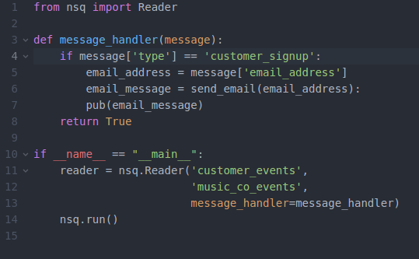
The event contains data
Downstream services parse the data they need to operate
E.g. the email service might look like...
NSQ is a queue reader

Slide 50
No more API calls!
The customer service just publishes an event
We no longer have to implement API clients (maybe don’t even have to write some!)
We can add downstream services without changing Customer, except possibly adding more data to the message
Reverse compatible!!!

Slide 51
How do we build these things? We’re Agile.
Customer satisfaction by early and continuous delivery of valuable software
Welcome changing requirements, even in late development
Working software is delivered frequently (weeks rather than months)
Close, daily cooperation between business people and developers
Projects are built around motivated individuals, who should be trusted
Face-to-face conversation is the best form of communication (co-location)
Working software is the primary measure of progress
Sustainable development, able to maintain a constant pace
Continuous attention to technical excellence and good design
Simplicity—the art of maximizing the amount of work not done—is essential
Best architectures, requirements, and designs emerge from self-organizing teams
Regularly, the team reflects on how to become more effective, and adjusts accordingly

Slide 52
Early, Continuous delivery
Coordinate directly with stakeholders on easy projects that generate value immediately
Have an idea in mind for the next easy step to keep generating value
Take on technical debt when necessary

Slide 53
2. Welcome change
Things change all the time
You want to find out early rather than after you finish an irrelevant project
Change means new opportunities
If project requirements change, it’s often because someone realized a better way to execute

Slide 54
3. Deliver often
Since change is constant, long timelines mean the world can change before you finish the project
Deliver early to get maximum value before the world changes

Slide 55
4. Close, daily cooperation with stakeholders
Developing code in a bubble doesn’t work
You have to be in touch with the end-users to know what will be useful
The closer you are, the sooner you’ll figure out changes in requirements

Slide 56
5. Projects are built around people you trust
If you don’t trust the team, they can’t operate autonomously
Top-down management is a bottleneck, and will keep teams from moving fast
Hire people you can trust to do the work. If you can’t trust them, don’t hire them.

Slide 57
6. Face-to-face communication is best
It’s easier to empathize with your stakeholder’s needs if you’re in the room with them
There are realities of workflow you won’t realize if you’re physically separated

Slide 58
7. Working software is the measure of progress
If ideas aren’t put into action, they’re not useful. Software is the manifestation of ideas
You’re writing code to reach goals. More functional software means (hopefully!) you’re reaching your goals. (see: motivated, trustworthy teams)

Slide 59
8. Sustainable pace of development
You’re not going at hack-a-thon speeds
You take time for planning meetings, and stepping back to see the big picture
Typically, you have “sprints” with “retrospectives” in between, as well as roadmapping and planning meetings.

Slide 60
9. Continuous attention to good design
Bad abstractions will cause you to slow down
Technical debt has to be re-paid eventually (see: sustainable pace of development!)

Slide 61
10. Simplicity is essential
Don’t optimize prematurely
Don’t abstract out patterns from a single use case -- it might be the wrong pattern!
Don’t include unnecessary features -- everything should be driven by the use case.

Slide 62
11. Best-architectures from self-organization
When teams are small and autonomous, they write small and autonomous services

Slide 63
12. Teams reflect regularly
Regularly examine what works and what doesn’t work
Was there some monitoring that could have saved time?
Was there some abstraction idea you missed, which resulted in too much coupling?
What are the sources of slow-downs?!
Daily “stand-up” meetings
What did you do yesterday
What are you doing today
What are your blockers/impediments?

Slide 64
These ideas work naturally with microservices
Small, autonomous teams writing small, autonomous services
De-coupling allows for fast development and simplifies changes as requirements change
Most services can be re-written in two weeks, so we can keep up with larger change in the org.
Each service can provide value, so incremental value is easy.

Slide 65
Example:
You want to build a recommender system
Where do you start?

Slide 66
Example:
A junior product manager wants to make a roadmap to reach a specific goal (building a certain service) by the end of the half
Is this Agile?

